Slide 1


Machine Learning 12. Ensemble Learning
Xueyuan Gong
School of Intelligent Systems Science and Engineering

Slide 2
Bagging
Bagging is the abbreviation of Bootstrap AGGregating
Recall that a model has its bias and variance
Bagging is helpful to reduce the high variance
Train models independently on random “resamples” of the training set
Combine multiple models to get the average result
It is a framework instead of just an algorithm
The most effective way to help you win AI competitions!

Slide 3
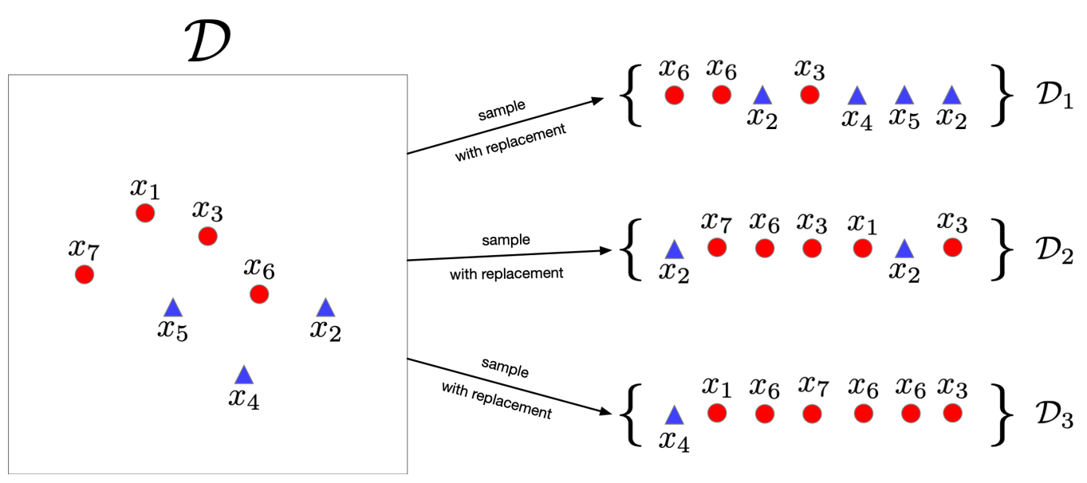
Bagging
First, bootstrap samples as multiple training sets from the data set

Slide 4
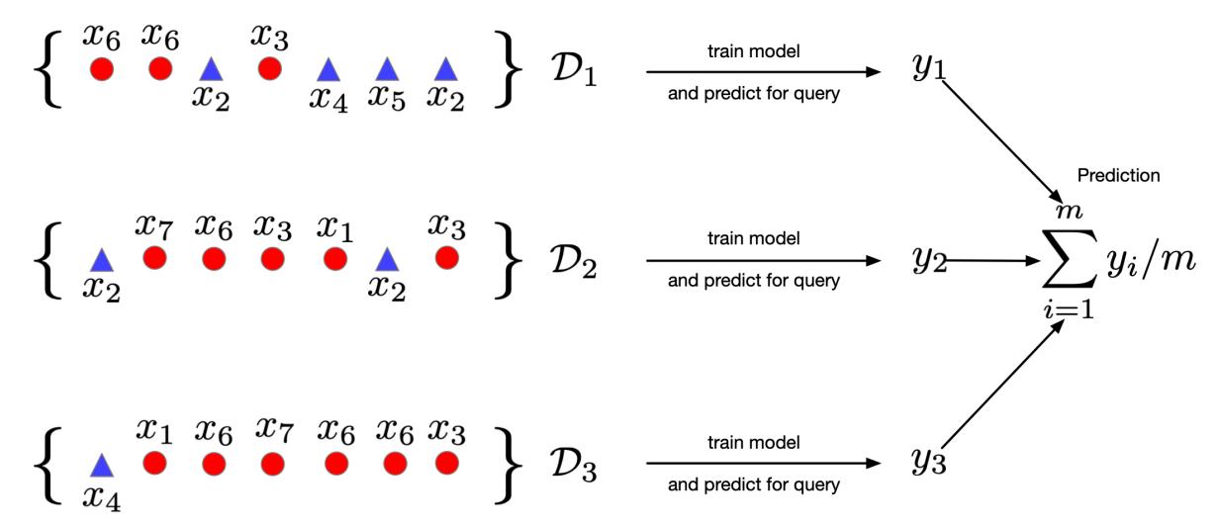
Bagging
Second, average the predictions of models trained on each of these training sets

Slide 5
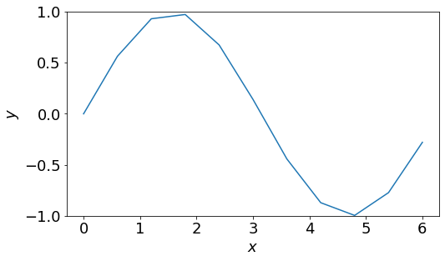
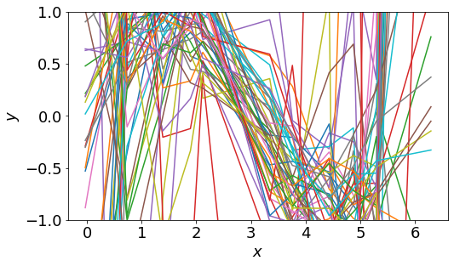
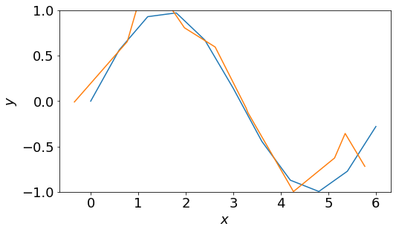
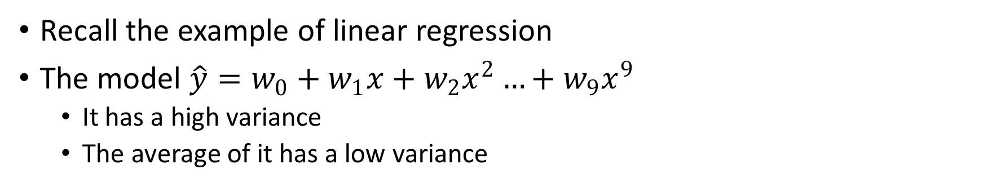
Bagging
Recall the example of linear regression
The model $\hat{y}=w_{0}+w_{1}x+w_{2}x^{2}…+w_{9}x^{9}$
It has a high variance
The average of it has a low variance
Sample space
Trained models
The average model

Slide 6
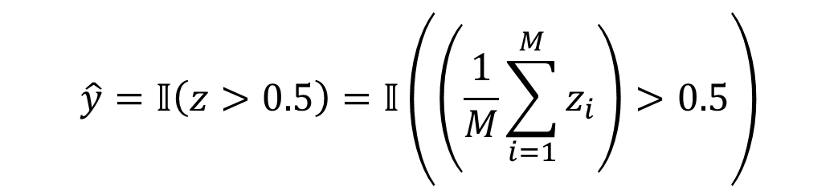
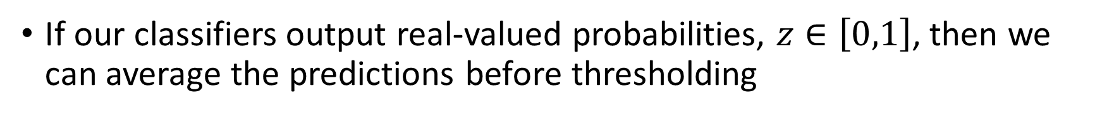
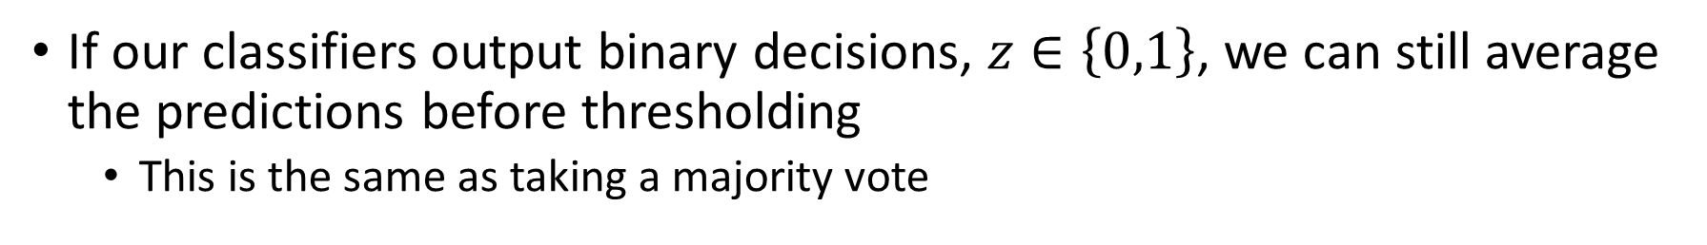
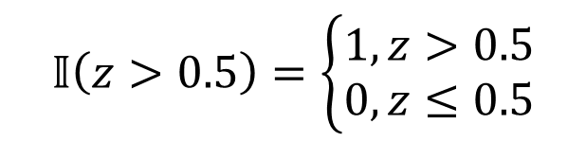
Bagging for Binary Classification
If our classifiers output real-valued probabilities, $z∈\left[0,1\right]$, then we can average the predictions before thresholding
$$\hat{y}=𝕀\left(z>0.5\right)=𝕀\left(\left(\frac{1}{M}\sum_{i=1}^{M}{z_{i}}\right)>0.5\right)$$
$$𝕀\left(z>0.5\right)=\left\{\begin{aligned}1,z>0.5 \\ 0,z≤0.5\end{aligned}\right.$$
If our classifiers output binary decisions, $z∈\left\{0,1\right\}$, we can still average the predictions before thresholding
This is the same as taking a majority vote

Slide 7
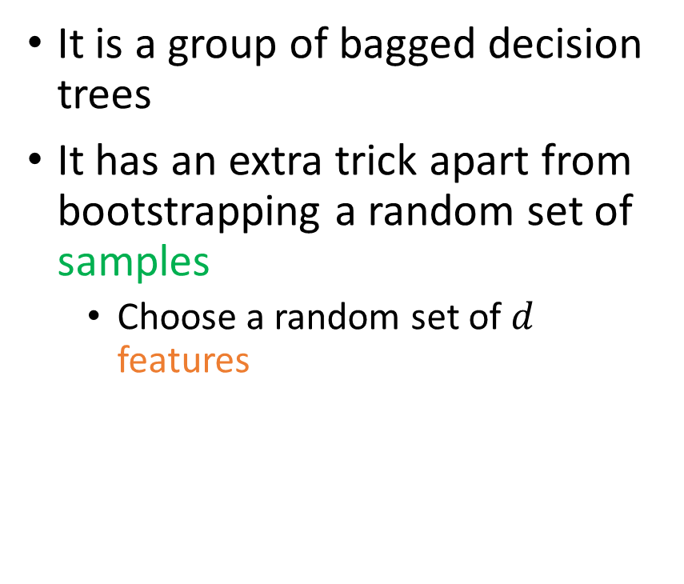
Random Forests
Index | Weather | Temperature | Humidity | Windy | Play Tennis
1 | Sunny | Hot | High | False | N
2 | Sunny | Hot | High | True | N
3 | Rainy | Cool | Normal | True | N
4 | Sunny | Mild | High | False | N
5 | Rainy | Mild | High | True | N
6 | Overcast | Hot | High | False | Y
7 | Rainy | Mild | High | False | Y
8 | Rainy | Cool | Normal | False | Y
9 | Overcast | Cool | Normal | True | Y
10 | Sunny | Cool | Normal | False | Y
11 | Rainy | Mild | Normal | False | Y
12 | Sunny | Mild | Normal | True | Y
13 | Overcast | Mild | High | True | Y
14 | Overcast | Hot | Normal | False | Y
It is a group of bagged decision trees
It has an extra trick apart from bootstrapping a random set of samples
Choose a random set of $d$ features

Slide 8
Summary of Bagging
Bagging is a framework
Used in most competition winners
It trains each model independently
Can execute parallelly
It does not reduce bias
Bagging is ineffective when the model is too simple with a small number of parameters

Slide 9
Boosting
Boosting is another ensemble learning framework
Train models sequentially
It helps to reduce bias but not variance
Boosting trains weak learners one after one to solve the problem step by step
AdaBoost (Adaptive Boosting) is a famous boosting approach

Slide 10
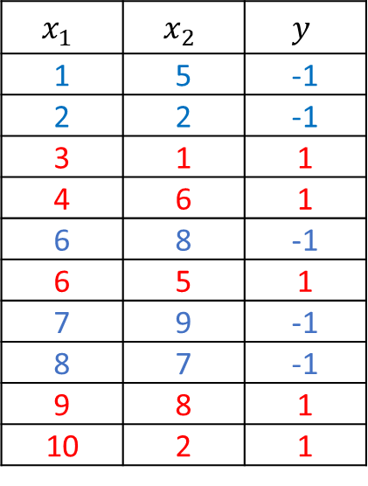
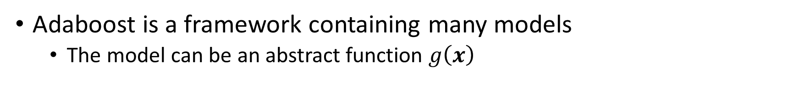
AdaBoost
Dataset
$$x_{1}$$ | $$x_{2}$$ | $$y$$
1 | 5 | -1
2 | 2 | -1
3 | 1 | 1
4 | 6 | 1
6 | 8 | -1
6 | 5 | 1
7 | 9 | -1
8 | 7 | -1
9 | 8 | 1
10 | 2 | 1
Adaboost is a framework containing many models
The model can be an abstract function $g\left(x\right)$

Slide 11
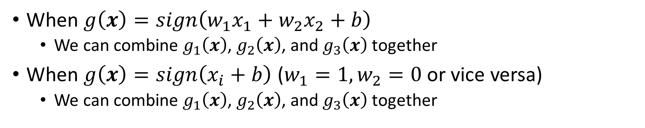

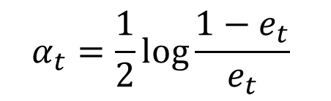
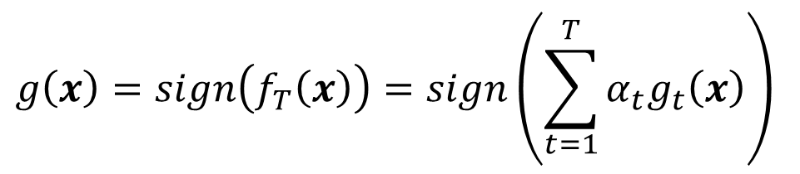
AdaBoost
When $g\left(x\right)=sign\left(w_{1}x_{1}+w_{2}x_{2}+b\right)$
We can combine $g_{1}\left(x\right)$, $g_{2}\left(x\right)$, and $g_{3}\left(x\right)$ together
When $g\left(x\right)=sign\left(x_{i}+b\right)$ ($w_{1}=1,w_{2}=0$ or vice versa)
We can combine $g_{1}\left(x\right)$, $g_{2}\left(x\right)$, and $g_{3}\left(x\right)$ together
$$\hat{y}$$
Model
The weak learner
$$g\left(x\right)=sign\left(f_{T}\left(x\right)\right)=sign\left(\sum_{t=1}^{T}{α_{t}g_{t}\left(x\right)}\right)$$
$$α_{t}=\frac{1}{2}\log{\frac{1−e_{t}}{e_{t}}}$$
The error of
the weak learner

Slide 12
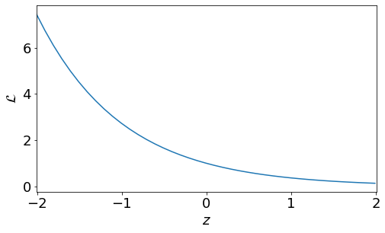

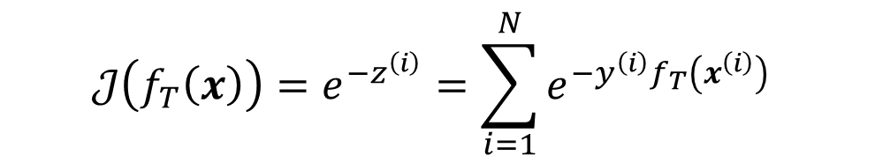
AdaBoost
Loss Function
$$ℒ\left(f_{T}\left(x\right)\right)=e^{−z}=e^{−{yf}_{T}\left(x\right)}$$
Cost Function
$$𝒥\left(f_{T}\left(x\right)\right)=e^{−z^{\left(i\right)}}=\sum_{i=1}^{N}{e^{−{y^{\left(i\right)}f}_{T}\left(x^{\left(i\right)}\right)}}$$

Slide 13
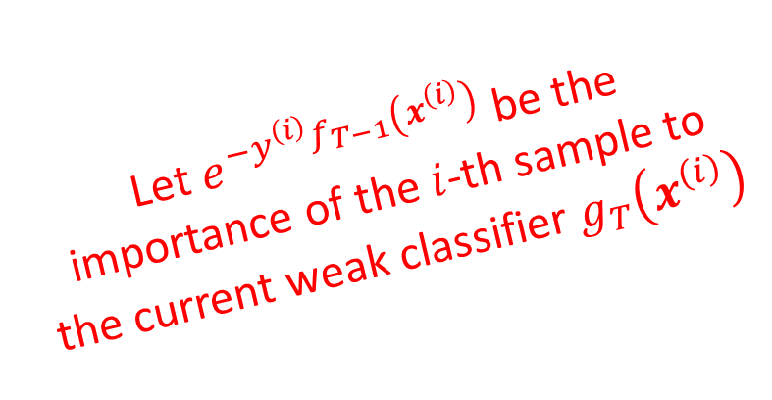
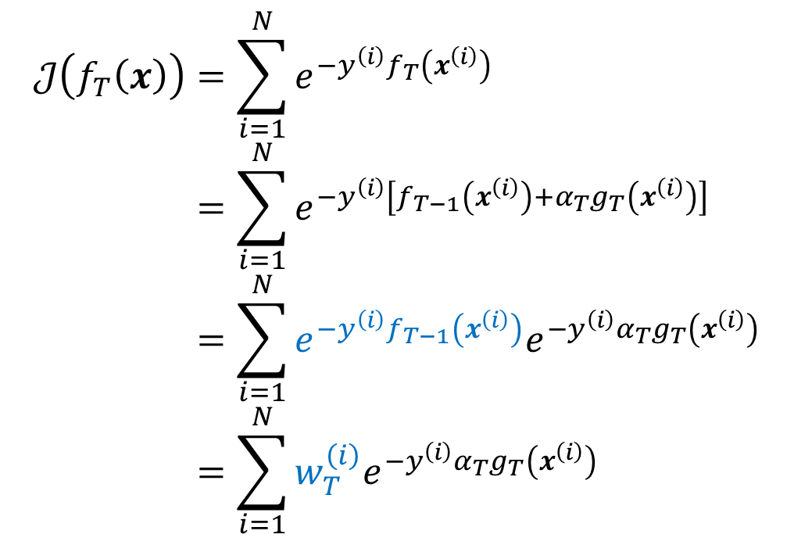
AdaBoost
$$𝒥\left(f_{T}\left(x\right)\right)=\sum_{i=1}^{N}{e^{−{y^{\left(i\right)}f}_{T}\left(x^{\left(i\right)}\right)}}=\sum_{i=1}^{N}{e^{−y^{\left(i\right)}\left[f_{T−1}\left(x^{\left(i\right)}\right)+α_{T}g_{T}\left(x^{\left(i\right)}\right)\right]}}=\sum_{i=1}^{N}{e^{−y^{\left(i\right)}f_{T−1}\left(x^{\left(i\right)}\right)}e^{−y^{\left(i\right)}α_{T}g_{T}\left(x^{\left(i\right)}\right)}}=\sum_{i=1}^{N}{w_{T}^{\left(i\right)}e^{−y^{\left(i\right)}α_{T}g_{T}\left(x^{\left(i\right)}\right)}}$$
Let $e^{−y^{\left(i\right)}f_{T−1}\left(x^{\left(i\right)}\right)}$ be the importance of the $i$-th sample to the current weak classifier $g_{T}\left(x^{\left(i\right)}\right)$

Slide 14
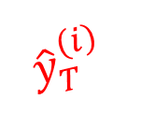
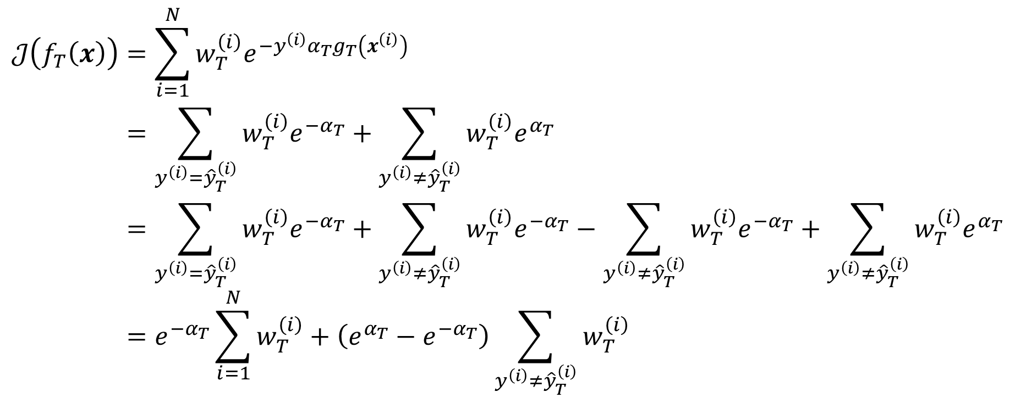
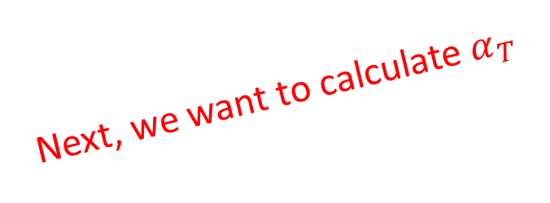
AdaBoost
$${\hat{y}}_{T}^{\left(i\right)}$$
$$𝒥\left(f_{T}\left(x\right)\right)=\sum_{i=1}^{N}{w_{T}^{\left(i\right)}e^{−y^{\left(i\right)}α_{T}g_{T}\left(x^{\left(i\right)}\right)}}=\sum_{y^{\left(i\right)}={\hat{y}}_{T}^{\left(i\right)}}{w_{T}^{\left(i\right)}e^{{−α}_{T}}}+\sum_{y^{\left(i\right)}≠{\hat{y}}_{T}^{\left(i\right)}}{w_{T}^{\left(i\right)}e^{α_{T}}}=\sum_{y^{\left(i\right)}={\hat{y}}_{T}^{\left(i\right)}}{w_{T}^{\left(i\right)}e^{{−α}_{T}}}+\sum_{y^{\left(i\right)}≠{\hat{y}}_{T}^{\left(i\right)}}{w_{T}^{\left(i\right)}e^{{−α}_{T}}}−\sum_{y^{\left(i\right)}≠{\hat{y}}_{T}^{\left(i\right)}}{w_{T}^{\left(i\right)}e^{{−α}_{T}}}+\sum_{y^{\left(i\right)}≠{\hat{y}}_{T}^{\left(i\right)}}{w_{T}^{\left(i\right)}e^{α_{T}}}=e^{{−α}_{T}}\sum_{i=1}^{N}{w_{T}^{\left(i\right)}}+\left(e^{α_{T}}−e^{{−α}_{T}}\right)\sum_{y^{\left(i\right)}≠{\hat{y}}_{T}^{\left(i\right)}}{w_{T}^{\left(i\right)}}$$
Next, we want to calculate $α_{T}$

Slide 15
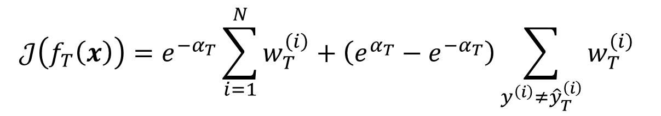
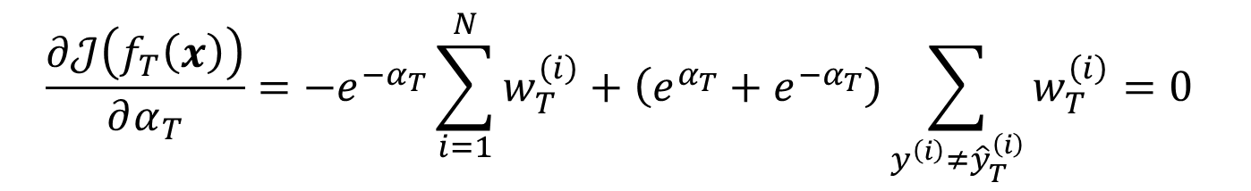
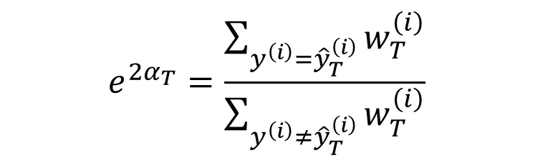
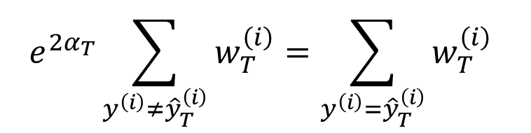
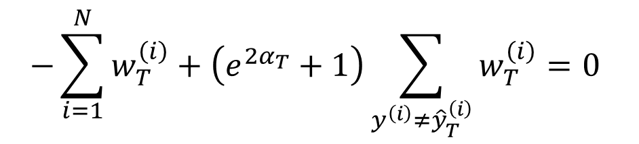
AdaBoost
$$𝒥\left(f_{T}\left(x\right)\right)=e^{{−α}_{T}}\sum_{i=1}^{N}{w_{T}^{\left(i\right)}}+\left(e^{α_{T}}−e^{{−α}_{T}}\right)\sum_{y^{\left(i\right)}≠{\hat{y}}_{T}^{\left(i\right)}}{w_{T}^{\left(i\right)}}$$
$$\frac{∂𝒥\left(f_{T}\left(x\right)\right)}{∂α_{T}}={−e}^{{−α}_{T}}\sum_{i=1}^{N}{w_{T}^{\left(i\right)}}+\left(e^{α_{T}}+e^{{−α}_{T}}\right)\sum_{y^{\left(i\right)}≠{\hat{y}}_{T}^{\left(i\right)}}{w_{T}^{\left(i\right)}}=0$$
$$−\sum_{i=1}^{N}{w_{T}^{\left(i\right)}}+\left(e^{{2α}_{T}}+1\right)\sum_{y^{\left(i\right)}≠{\hat{y}}_{T}^{\left(i\right)}}{w_{T}^{\left(i\right)}}=0$$
$$e^{{2α}_{T}}\sum_{y^{\left(i\right)}≠{\hat{y}}_{T}^{\left(i\right)}}{w_{T}^{\left(i\right)}}=\sum_{y^{\left(i\right)}={\hat{y}}_{T}^{\left(i\right)}}{w_{T}^{\left(i\right)}}$$
$$e^{{2α}_{T}}=\frac{\sum_{y^{\left(i\right)}={\hat{y}}_{T}^{\left(i\right)}}{w_{T}^{\left(i\right)}}}{\sum_{y^{\left(i\right)}≠{\hat{y}}_{T}^{\left(i\right)}}{w_{T}^{\left(i\right)}}}$$

Slide 16
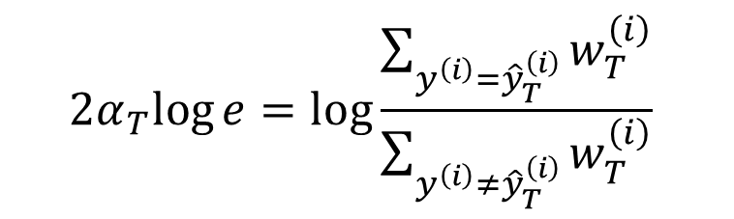
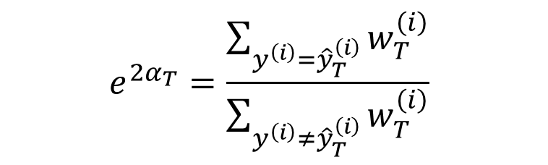
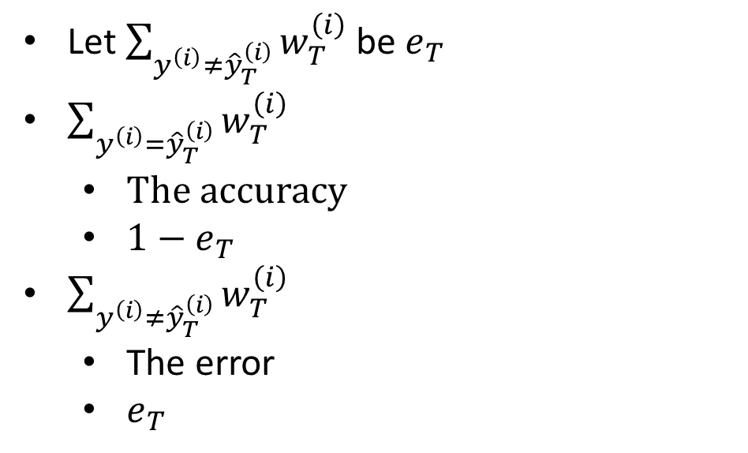
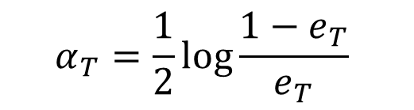
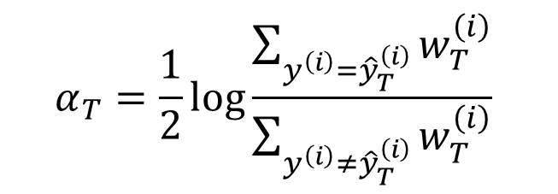
AdaBoost
$$e^{{2α}_{T}}=\frac{\sum_{y^{\left(i\right)}={\hat{y}}_{T}^{\left(i\right)}}{w_{T}^{\left(i\right)}}}{\sum_{y^{\left(i\right)}≠{\hat{y}}_{T}^{\left(i\right)}}{w_{T}^{\left(i\right)}}}$$
Let $\sum_{y^{\left(i\right)}≠{\hat{y}}_{T}^{\left(i\right)}}{w_{T}^{\left(i\right)}}$ be $e_{T}$
$\sum_{y^{\left(i\right)}={\hat{y}}_{T}^{\left(i\right)}}{w_{T}^{\left(i\right)}}$
The accuracy
$1−e_{T}$
$\sum_{y^{\left(i\right)}≠{\hat{y}}_{T}^{\left(i\right)}}{w_{T}^{\left(i\right)}}$
The error
$e_{T}$
$$2α_{T}log{e}=\log{\frac{\sum_{y^{\left(i\right)}={\hat{y}}_{T}^{\left(i\right)}}{w_{T}^{\left(i\right)}}}{\sum_{y^{\left(i\right)}≠{\hat{y}}_{T}^{\left(i\right)}}{w_{T}^{\left(i\right)}}}}$$
$$α_{T}=\frac{1}{2}\log{\frac{\sum_{y^{\left(i\right)}={\hat{y}}_{T}^{\left(i\right)}}{w_{T}^{\left(i\right)}}}{\sum_{y^{\left(i\right)}≠{\hat{y}}_{T}^{\left(i\right)}}{w_{T}^{\left(i\right)}}}}$$
$$α_{T}=\frac{1}{2}\log{\frac{1−e_{T}}{e_{T}}}$$

Slide 17

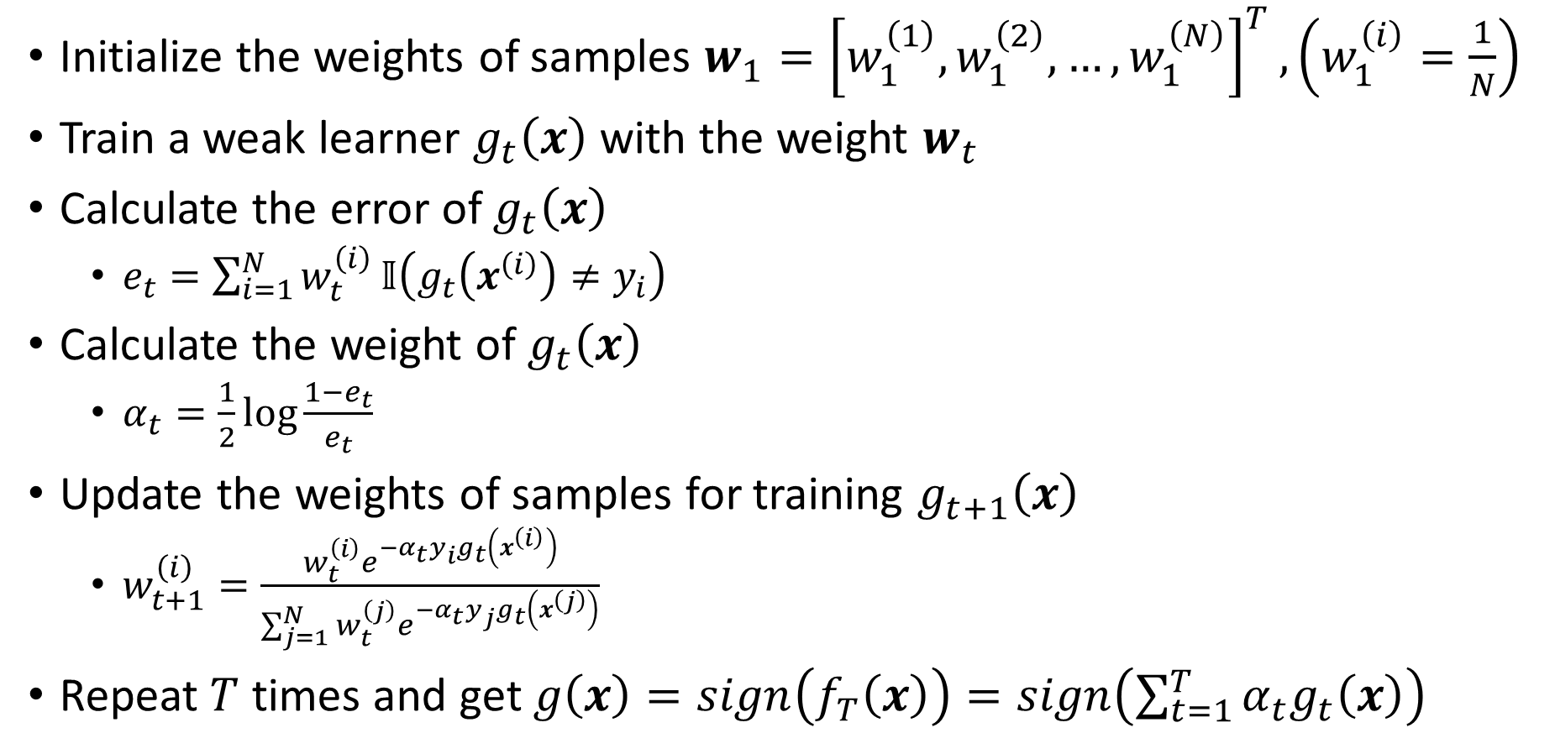
AdaBoost
Initialize the weights of samples $w_{1}={\left[w_{1}^{\left(1\right)},w_{1}^{\left(2\right)},…,w_{1}^{\left(N\right)}\right]}^{T},\left(w_{1}^{\left(i\right)}=\frac{1}{N}\right)$
Train a weak learner $g_{t}\left(x\right)$with the weight $w_{t}$
Calculate the error of $g_{t}\left(x\right)$
$e_{t}=\sum_{i=1}^{N}{w_{t}^{\left(i\right)}}𝕀\left(g_{t}\left(x^{\left(i\right)}\right)≠y_{i}\right)$
Calculate the weight of $g_{t}\left(x\right)$
$α_{t}=\frac{1}{2}\log{\frac{1−e_{t}}{e_{t}}}$
Update the weights of samples for training $g_{t+1}\left(x\right)$
$w_{t+1}^{\left(i\right)}=\frac{w_{t}^{\left(i\right)}e^{−α_{t}y_{i}g_{t}\left(x^{\left(i\right)}\right)}}{\sum_{j=1}^{N}{w_{t}^{\left(j\right)}e^{−α_{t}y_{j}g_{t}\left(x^{\left(j\right)}\right)}}}$
Repeat $T$ times and get $g\left(x\right)=sign\left(f_{T}\left(x\right)\right)=sign\left(\sum_{t=1}^{T}{α_{t}g_{t}\left(x\right)}\right)$
$$\sum_{y^{\left(i\right)}≠{\hat{y}}_{t}^{\left(i\right)}}{w_{t}^{\left(i\right)}}$$

Slide 18
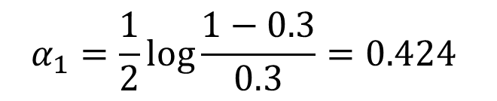

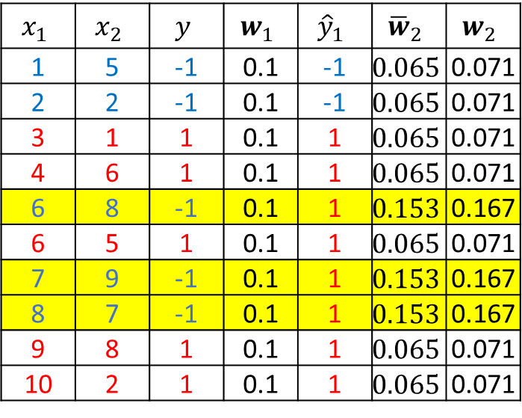
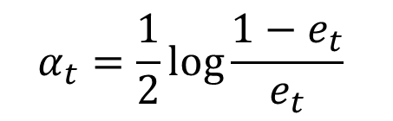
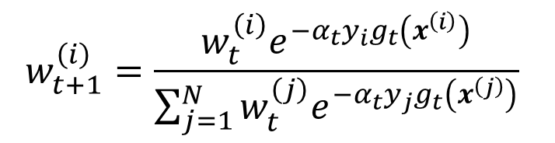



Example
$$α_{t}=\frac{1}{2}\log{\frac{1−e_{t}}{e_{t}}}$$
$$w_{t+1}^{\left(i\right)}=\frac{w_{t}^{\left(i\right)}e^{−α_{t}y_{i}g_{t}\left(x^{\left(i\right)}\right)}}{\sum_{j=1}^{N}{w_{t}^{\left(j\right)}e^{−α_{t}y_{j}g_{t}\left(x^{\left(j\right)}\right)}}}$$
$$x_{1}$$ | $$x_{2}$$ | $$y$$ | $$w_{1}$$ | $${\hat{y}}_{1}$$ | $${\overline{w}}_{2}$$ | $$w_{2}$$
1 | 5 | -1 | 0.1 | -1 | $$0.065$$ | 0.071
2 | 2 | -1 | 0.1 | -1 | $$0.065$$ | 0.071
3 | 1 | 1 | 0.1 | 1 | $$0.065$$ | 0.071
4 | 6 | 1 | 0.1 | 1 | $$0.065$$ | 0.071
6 | 8 | -1 | 0.1 | 1 | $$0.153$$ | 0.167
6 | 5 | 1 | 0.1 | 1 | $$0.065$$ | 0.071
7 | 9 | -1 | 0.1 | 1 | $$0.153$$ | 0.167
8 | 7 | -1 | 0.1 | 1 | $$0.153$$ | 0.167
9 | 8 | 1 | 0.1 | 1 | $$0.065$$ | 0.071
10 | 2 | 1 | 0.1 | 1 | $$0.065$$ | 0.071
$${\hat{y}}_{1}=sign\left(x_{1}−2.5\right)$$
$${\overline{w}}_{2}^{\left(5\right)}=0.1e^{−0.424×−1×1}=0.153$$
$$e_{1}=0.1+0.1+0.1=0.3$$
$$α_{1}=\frac{1}{2}\log{\frac{1−0.3}{0.3}}=0.424$$
$${\overline{w}}_{2}^{\left(1\right)}=0.1e^{−0.424×1×1}=0.065$$

Slide 19
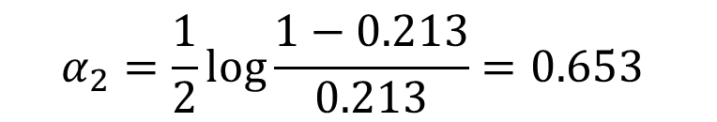

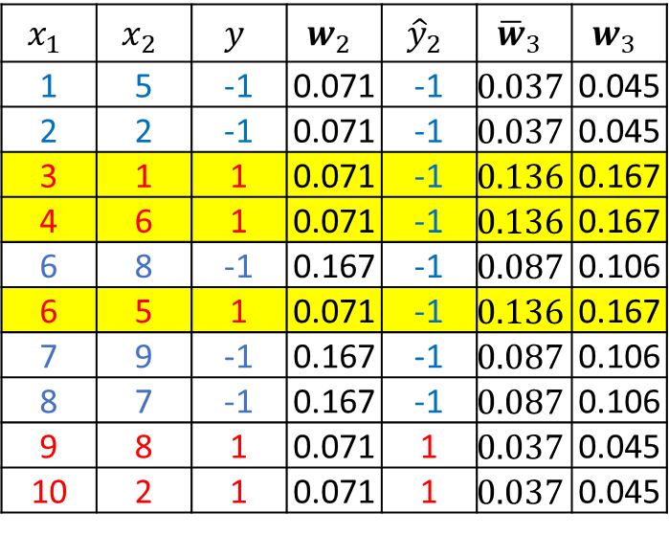




Example
$$α_{t}=\frac{1}{2}\log{\frac{1−e_{t}}{e_{t}}}$$
$$w_{t+1}^{\left(i\right)}=\frac{w_{t}^{\left(i\right)}e^{−α_{t}y_{i}g_{t}\left(x^{\left(i\right)}\right)}}{\sum_{j=1}^{N}{w_{t}^{\left(j\right)}e^{−α_{t}y_{j}g_{t}\left(x^{\left(j\right)}\right)}}}$$
$$x_{1}$$ | $$x_{2}$$ | $$y$$ | $$w_{2}$$ | $${\hat{y}}_{2}$$ | $${\overline{w}}_{3}$$ | $$w_{3}$$
1 | 5 | -1 | 0.071 | -1 | $$0.037$$ | 0.045
2 | 2 | -1 | 0.071 | -1 | $$0.037$$ | 0.045
3 | 1 | 1 | 0.071 | -1 | $$0.136$$ | 0.167
4 | 6 | 1 | 0.071 | -1 | $$0.136$$ | 0.167
6 | 8 | -1 | 0.167 | -1 | $$0.087$$ | 0.106
6 | 5 | 1 | 0.071 | -1 | $$0.136$$ | 0.167
7 | 9 | -1 | 0.167 | -1 | $$0.087$$ | 0.106
8 | 7 | -1 | 0.167 | -1 | $$0.087$$ | 0.106
9 | 8 | 1 | 0.071 | 1 | $$0.037$$ | 0.045
10 | 2 | 1 | 0.071 | 1 | $$0.037$$ | 0.045
$${\hat{y}}_{2}=sign\left(x_{1}−8.5\right)$$
$${\overline{w}}_{3}^{\left(3\right)}=0.071e^{0.653}=0.136$$
$$e_{2}=0.071×3=0.213$$
$${\overline{w}}_{3}^{\left(1\right)}=0.071e^{−0.653}=0.037$$
$$α_{2}=\frac{1}{2}\log{\frac{1−0.213}{0.213}}=0.653$$
$${\overline{w}}_{3}^{\left(5\right)}=0.167e^{−0.653}=0.087$$

Slide 20
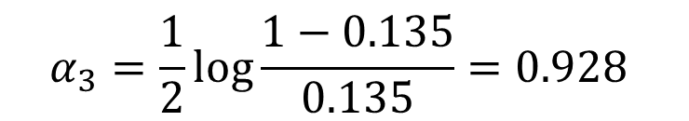


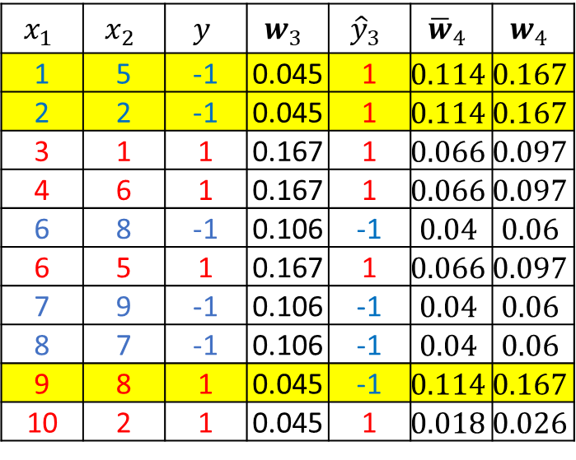




Example
$$α_{t}=\frac{1}{2}\log{\frac{1−e_{t}}{e_{t}}}$$
$$w_{t+1}^{\left(i\right)}=\frac{w_{t}^{\left(i\right)}e^{−α_{t}y_{i}g_{t}\left(x^{\left(i\right)}\right)}}{\sum_{j=1}^{N}{w_{t}^{\left(j\right)}e^{−α_{t}y_{j}g_{t}\left(x^{\left(j\right)}\right)}}}$$
$$x_{1}$$ | $$x_{2}$$ | $$y$$ | $$w_{3}$$ | $${\hat{y}}_{3}$$ | $${\overline{w}}_{4}$$ | $$w_{4}$$
1 | 5 | -1 | 0.045 | 1 | $$0.114$$ | $$0.167$$
2 | 2 | -1 | 0.045 | 1 | $$0.114$$ | $$0.167$$
3 | 1 | 1 | 0.167 | 1 | $$0.066$$ | $$0.097$$
4 | 6 | 1 | 0.167 | 1 | $$0.066$$ | $$0.097$$
6 | 8 | -1 | 0.106 | -1 | $$0.04$$ | $$0.06$$
6 | 5 | 1 | 0.167 | 1 | $$0.066$$ | $$0.097$$
7 | 9 | -1 | 0.106 | -1 | $$0.04$$ | $$0.06$$
8 | 7 | -1 | 0.106 | -1 | $$0.04$$ | $$0.06$$
9 | 8 | 1 | 0.045 | -1 | $$0.114$$ | $$0.167$$
10 | 2 | 1 | 0.045 | 1 | $$0.018$$ | $$0.026$$
$${\hat{y}}_{3} =sign\left(6.5−x_{2}\right)$$
$${\overline{w}}_{4}^{\left(1\right)}=0.045e^{0.928}=0.114$$
$$e_{3}=0.045×3=0.135$$
$${\overline{w}}_{4}^{\left(3\right)}=0.167e^{−0.928}=0.066$$
$$α_{3}=\frac{1}{2}\log{\frac{1−0.135}{0.135}}=0.928$$
$${\overline{w}}_{4}^{\left(5\right)}=0.106e^{−0.928}=0.04$$
$${\overline{w}}_{4}^{\left(10\right)}=0.045e^{−0.928}=0.018$$

Slide 21
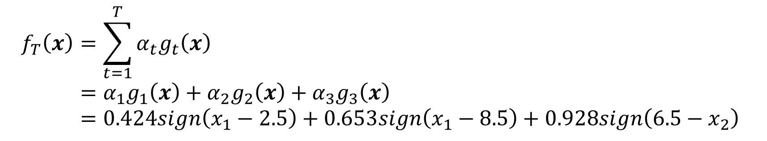
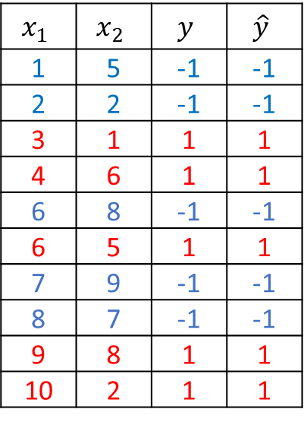

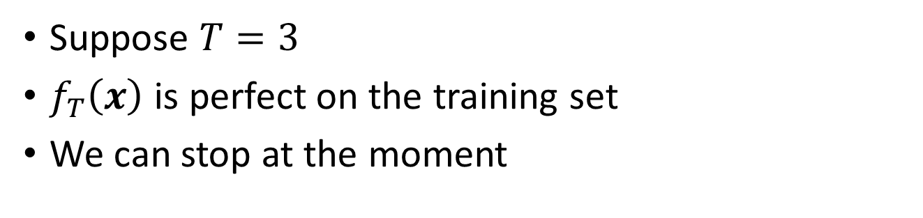
Example
Suppose $T=3$
$f_{T}\left(x\right)$ is perfect on the training set
We can stop at the moment
$$x_{1}$$ | $$x_{2}$$ | $$y$$ | $$\hat{y}$$
1 | 5 | -1 | -1
2 | 2 | -1 | -1
3 | 1 | 1 | 1
4 | 6 | 1 | 1
6 | 8 | -1 | -1
6 | 5 | 1 | 1
7 | 9 | -1 | -1
8 | 7 | -1 | -1
9 | 8 | 1 | 1
10 | 2 | 1 | 1
$$\hat{y}=sign\left(f_{T}\left(x\right)\right)$$
$$f_{T}\left(x\right)=\sum_{t=1}^{T}{α_{t}g_{t}\left(x\right)}=α_{1}g_{1}\left(x\right)+α_{2}g_{2}\left(x\right)+α_{3}g_{3}\left(x\right)=0.424sign\left(x_{1}−2.5\right)+0.653sign\left(x_{1}−8.5\right)+0.928sign\left(6.5−x_{2}\right)$$

Slide 22
Ensembles Recap
Ensembles combine models to improve performance
Bagging
Reduce variance
Bias is not changed
Parallel
Want to minimize correlation between ensemble elements
Boosting
Reduce bias
Increases variance
Sequential
High dependency between ensemble elements

Slide 23
Thank you！

